Slide 1

Cracking the Code to Increase Men’s Uptake of HIV Testing in Malawi:
Providing Convenient And Confidential HIV Testing Services Through Mobile Clinics
Elizabeth Geoffroy
Director of International Programs
Global AIDS Interfaith Alliance (GAIA)
emgeoffroy@thegaia.org
WEAE01
Reaching men: Yes we can!
Wednesday 25 July, 11:00 – 12:30
Joel Goldman, The Elizabeth Taylor AIDS Foundation
Nelson Khozomba, GAIA Malawi
Ellen Schell, GAIA USA
Joyce Jere, GAIA Malawi
Todd Schafer, GAIA USA
Pempho Nyangulu, Interim District Health Officer for Mulanje

Slide 2

OUTLINE
Background on HIV epidemic in Malawi
Mobile health clinic model
Barriers and facilitators to HTS for men
Mobile male-targeted testing program results
Lessons learned
Next steps

Slide 3
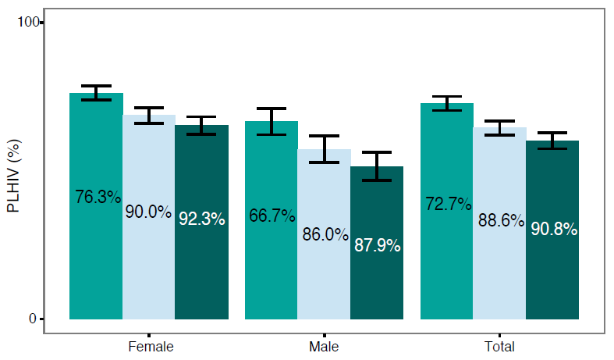
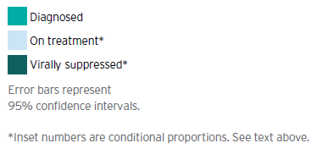
HIV in Malawi
Malawi is on track to meet UNAIDS 90-90-90 treatment targets
Largest gap in HIV treatment cascade is in HIV testing
67% of men age 15-64 living with HIV know their status compared with 76% of women of the same age
Source: MPHIA Study 2015- 2016
Notes:
As such, men living with HIV are less likely to be on treatment, virally suppressed and account for more AIDS related mortality and morbidity
In particular men age 15-24 are much less likely to have been tested in the previous year, only about 25% reported testing in the previous 12 months compared with nearly 40% of women in the same age group.

Slide 4
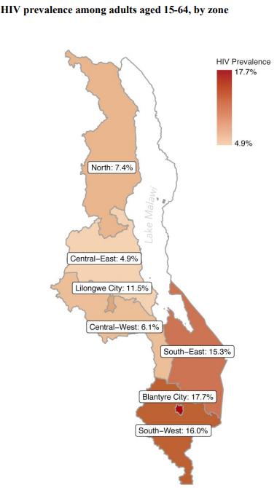
HIV in Malawi
Nationally, 9.6% of adults are HIV positive and 3% of those tested for HIV in 2018 q1 were newly found positive.
In Mulanje District, 21% of adults are HIV positive and 4.6% of those tested for HIV in 2018 q1 were newly found positive.
Mulanje District
Source: MPHIA Study 2015- 2016

Slide 5
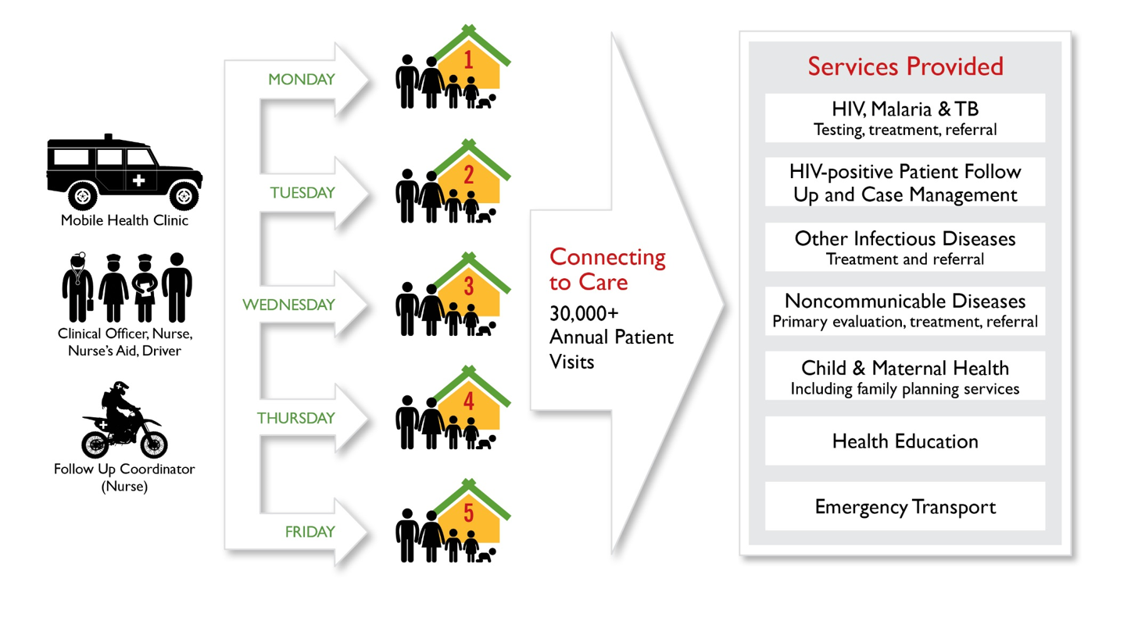
GAIA Mobile HIV Testing Services
GAIA has operated weekday mobile basic health care clinics in Southern Malawi which provide integrated HIV testing, counseling and referral since 2008
Notes:
Each clinic has a catchment area of about 50,000 people

Slide 6
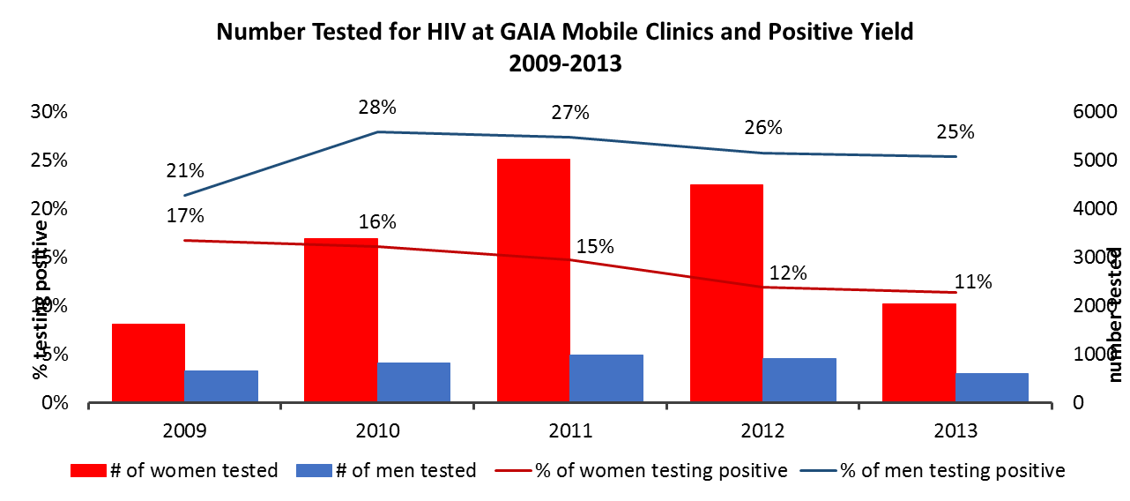
GAIA Mobile HIV Testing Services
Program data from 2009-2013 revealed a sustained gap in the male to female testing ratio
Male clients coming to the clinic for HIV testing were generally already quite sick
Notes:
Men were only being tested at weekday mobile clinics when they were already very sick, poorer health outcomes

Slide 7
Photo by Quinn Tivey
The Elizabeth Taylor AIDS Foundation
Notes:
Weekday clinics were not necessarily male friendly spaces, since clients were overwhelming women and children

Slide 8
Understanding HIV Testing
Barriers and Facilitators for Men
GAIA conducted a formative evaluation in 2014 to better understand barriers and facilitators to HTS for men
  Partnered with University of California, San Francisco
  Qualitative study with 30 men, both villagers and village opinion leaders
    Interviews centered around three open-ended questions
      How have you been affected by HIV?
      What have you heard about HIV testing?
      What would make you more likely to get tested?

Slide 9
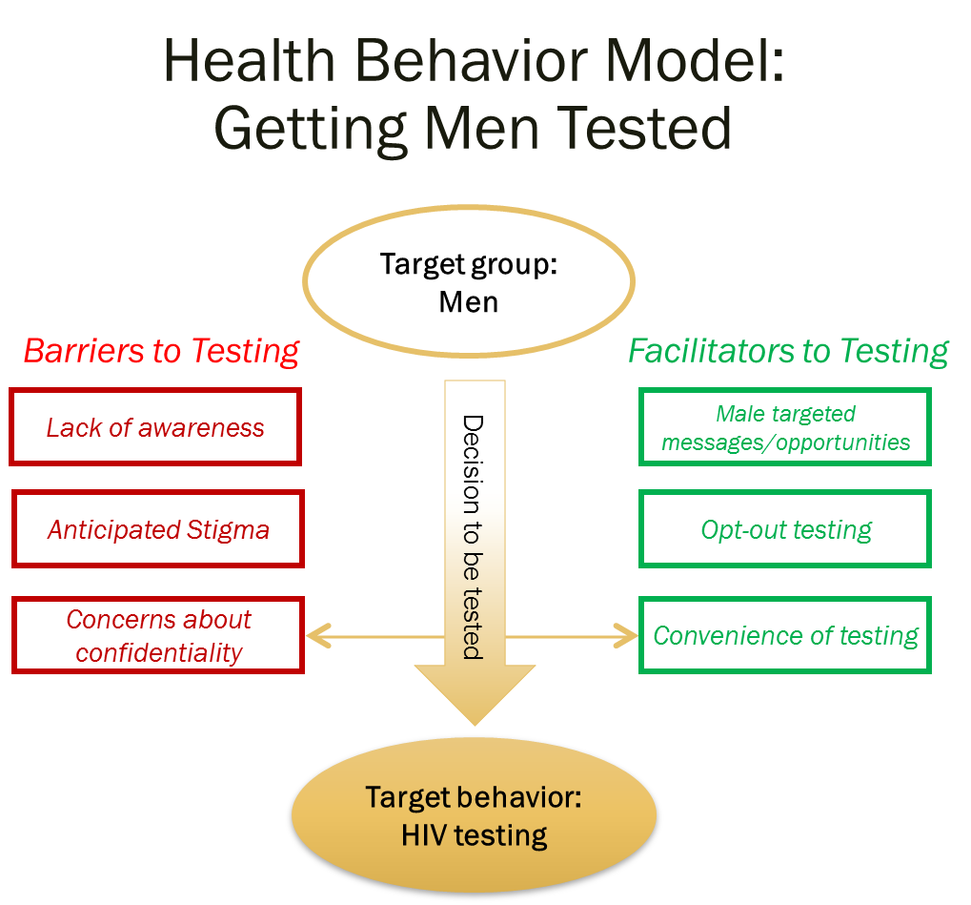
Understanding HIV Testing
Barriers and Facilitators for Men
Figure credit: John Weinstein, Director of Research and Assistant Professor of Medicine, Boston University
Notes:
Convenience of testing time and location

Slide 10
Understanding HIV Testing
Barriers and Facilitators for Men
Based on the results of the study, GAIA addressed barriers to HIV testing for men by:
Holding community sensitization meetings in places where men gathered to encourage male testing and notify them of opportunities to be tested
Employing male HTS counselors and ensuring confidentiality by rotating counselors
Implementing convenient weekend testing events, targeting men and their partners and children
Notes:
Convenience in terms of location and timing

Slide 11
Weekend Male Targeted Testing
Program implementation
Utilized existing underused resources – clinic vehicles and staff on weekend days
Partnered with the Mulanje District Health Office to identify underserved and high risk sites
Engaged large employers to offer opportunities for worker testing
Engaged community opinion leaders, faith leaders to encourage testing
Service provided by 3 - 4 HTS counselors, a nurse or clinical officer and a driver
Conducted HTS at:
  work sites (tea estates, construction sites, markets)
  community sites (schools, community centers, alongside fixed health facilities)
  Places of worship (church & mosques)
Collected data using a mobile data collection app to access real time data and enable high yield/risk areas to be targeted for testing

Slide 12
Photo by Samora Chapman

Slide 13
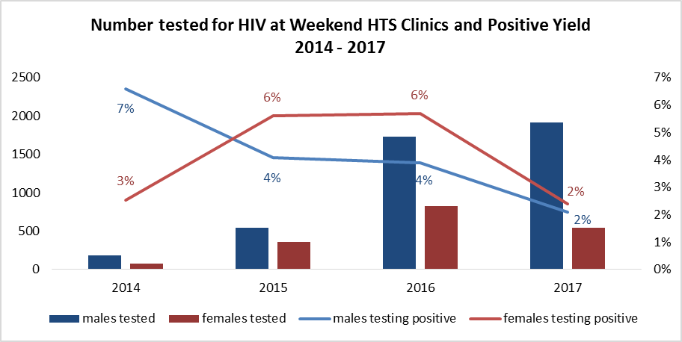
Weekend Male Targeted Testing
July 2014 to December 2017 results:
106 male targeted testing events
6,166 people tested
  71% of those tested were male (n=4,360) compared with 26% at weekday mobile clinics
The percentage of men attending events increased from 69% in 2014 to 78% in 2017.
Men cited
  Convenience of location (38%)
  Publicity surrounding the event (35%)
  Convenience of time (23%)
  as the primary reasons for attending the clinic
Notes:
This program has been scaled up
Test and treat began in September 2016

Slide 14
Weekend Male Targeted Testing
Young Men age 15-24
  42% had not previously been tested
  1.2% tested positive
Men over age 25
  20% had not previously been tested
  5% tested positive
Across all ages
  30% of males had not been previously tested
  3% of men tested were found positive

Slide 15
Weekend Male Targeted Testing

Slide 16
Weekend Male Targeted Testing
Referrals
All those testing positive were referred for confirmatory testing and ART initiation, and encouraged to ensure partners and children seek testing
Males testing negative were referred for VMMC and other prevention services

Slide 17
Lessons Learned
Young men and first time testers can effectively be reached through mobile male targeted testing
Community sensitization and convenient and confidential services can improve male uptake of HIV testing
Using real time data to assess high risk areas in need of testing can improve targeting and program performance
Notes:
Some of these men may not have otherwise been tested.

Slide 18
Next Steps
The program was expanded in March 2018
2 clinics are now holding 10 total events per week in the highest risk areas and male work sites within the district
We are now linking testing data with treatment initiation and adherence data at the district level
Planning to hold family testing days where men can bring or direct their families and sexual partners for testing and counseling
Photo by Samora Chapman

Slide 19
Thank you!
Elizabeth Geoffroy
Director of International Programs
Global AIDS Interfaith Alliance (GAIA)
emgeoffroy@thegaia.org
Joel Goldman, The Elizabeth Taylor AIDS Foundation
Nelson Khozomba, GAIA Malawi
Ellen Schell, GAIA USA
Joyce Jere, GAIA Malawi
Todd Schafer, GAIA USA
Pempho Nyangulu, Mulanje, Malawi District Heath Officer
WEAE01
Reaching men: Yes we can!
Wednesday 25 July, 11:00 – 12:30

